Slide 1
Electromagnetism
Electric fields
Magnetism
Electromagnetism
Motors
Induction
Generators
Transformers
Power Transmission

Slide 2

SCSA ATAR Syllabus (last updated 23/5/19; https://senior-secondary.scsa.wa.edu.au/syllabus-and-support-materials/science/physics)
Science Understanding
electrostatically charged objects exert a force upon one another; the magnitude of this force can be calculated using Coulomb’s Law
This includes applying the relationship
$F=\frac{1}{4πε0}\frac{q1q2}{r2}$
point charges and charged objects produce an electric field in the space that surrounds them; field theory attributes the electrostatic force on a point charge or charged body to the presence of an electric field
a positively charged body placed in an electric field will experience a force in the direction of the field; the strength of the electric field is defined as the force per unit charge
This includes applying the relationship
$E=\frac{F}{q}=\frac{V}{d}$
when a charged body moves or is moved from one point to another in an electric field and its potential energy changes, work is done on the charge by the field
This includes applying the relationship
$V=\frac{W}{q}$
the direction of conventional current is that in which the flow of positive charges takes place, while the electron flow is in the opposite direction
current-carrying wires are surrounded by magnetic fields; these fields are utilised in solenoids and electromagnets
the strength of the magnetic field produced by a current is a measure of the magnetic flux density
This includes applying the relationship
$B=\frac{μ0}{2π}\frac{I}{r}$
magnets, magnetic materials, moving charges and current-carrying wires experience a force in a magnetic field when they cut flux lines; this force is utilised in DC electric motors and particle accelerators
This includes applying the relationships
$F=qvB where v⊥B,$ $F=IlB where l⊥B$
the force due to a current in a magnetic field in a DC electric motor produces a torque on the coil in the motor
This includes applying the relationship
$τ=r⊥F$
an induced emf is produced by the relative motion of a straight conductor in a magnetic field when the conductor cuts flux lines
This includes applying the relationship
$induced emf=lvB where v⊥B$
magnetic flux is defined in terms of magnetic flux density and area
This includes applying the relationship
$φ=BA⊥$
a changing magnetic flux induces a potential difference; this process of electromagnetic induction is used in step-up and step-down transformers, DC and AC generators
This includes applying the relationships
$induced emf=−N\frac{\left(Φ2−Φ1\right)}{t}=−N\frac{Δφ}{t}=−N\frac{Δ(BA⊥)}{t}$
$AC generator emfmax=2NlvB=2πNBA⊥f, emfrms=\frac{emfmax}{\sqrt{2}}$
$\frac{Vp}{Vs}=\frac{Np}{Ns}$
$P=VI=I2R=\frac{V2}{R}$
conservation of energy, expressed as Lenz’s Law of electromagnetic induction, is used to determine the direction of induced current
Science as a Human Endeavour
Electromagnetism is utilised in a range of technological applications, including:
DC electric motor with commutator, and back emf; AC and DC generators; transformers; regenerative braking; induction hotplates; large scale AC power distribution systems

Slide 3
Drawing electric field lines
Field lines start and end on charges
Field lines must not cross
Field lines at the surface of a charged object must be perpendicular to the surface
Density of field lines shows strength of field
http://www.flashphysics.org/electricField.html
Must be able to draw the following scenarios
Point charge
Like point charges
Unlike point charges
Parallel plates
Parallel plate and point charge
3 point charges

Slide 4
Drawing Electric Field lines
Positive point charge Two like point charges
+
+
+

Slide 5
Electric fields
A region in space in which charged particles experience a force
Direction of field is the direction that a positive charge would be pushed
-
+

Slide 6
Drawing Electric Field lines
Unlike point charges Parallel plates
+++++++++++++++++++++++++++
+
-
------------------------------------------------------

Slide 7
Drawing Electric Field lines
Parallel plates and point charge 3 point charges
+++++++++++++++++++++++++++
+
+
+
------------------------------------------------------
-

Slide 8
Lines of equipotential
Show lines of equal electric potential – similar to contour lines on a map
Typically drawn as dashed lines to contrast with the solid field lines
Lines of equipotential must be perpendicular to field lines
Field strength equals the gradient of electric potential – the closer the lines of equipotential are the higher the field strength

Slide 9
Lines of equipotential
Positive point charge Two like point charges
+
+
+
Lines of equipotential get increasingly further apart away from a point charge – inverse square law

Slide 10
Lines of equipotential
Unlike point charges Parallel plates
+++++++++++++++++++++++++++
+
-
------------------------------------------------------
Lines of equipotential evenly spaced and parallel between parallel plates so it is a uniform electric field

Slide 11

Coulomb’s law
Force of attraction OR repulsion between two charged objects
$$F=k\frac{q1q2}{r2}=\frac{1}{4πε0}\frac{q1q2}{r2}$$
$$k=Coulomb′s constant (9×{10}^{9} N m2 C^{−2})$$
$$q=charges of the two objects \left(C\right)$$
$$r=distance between the two objects \left(m\right)$$
Note that this follows an inverse square law

Slide 12

Sidebar - Coulomb’s constant
$$k=\frac{1}{4πε0}$$
$$k=Coulomb′s constant (9×{10}^{9} N m2 C^{−2})$$
$$ε0=electric constant or vacuum permittivity \left(8.85×{10}^{−12} F m^{−1}\right)$$
$ε0$ is the value used in a vacuum, there are different values of permittivity for different media but for our purposes we will always uses $ε0$

Slide 13

Coulomb’s Law example 1
Calculate the size of the force between a proton and an electron in a H-1 atom. Assume they are 8x10⁻¹¹ m apart.
$$F=\frac{1}{4πε0}\frac{q1q2}{r2}=\frac{{(1.6×{10}^{−19})}^{2}}{{4π(8.85×{10}^{−12})(8×{10}^{−11})}^{2}}$$
$$=3.60×{10}^{−8} N attraction$$

Slide 14

Inverse Square recap
Can use
$$F_{1}r_{1}^{2}=F_{2}r_{2}^{2}$$
By what factor does the force between two charged particles change if the charge of one particle halves and the distance between the two quarters?
Multiplied by factor of 8

Slide 15

Electric Field Strength (E)
The force per unit (positive) charge at a point in an electric field (N C⁻¹)
$$E=\frac{F}{q} so F=Eq$$
It is a vector

Slide 16


Electric Field Strength
Recall that:
$$F=k\frac{q1q2}{r2}=\frac{1}{4πε0}\frac{q1q2}{r2}$$
So:
$$E=k\frac{q}{r2}=\frac{1}{4πε0}\frac{q}{r2}$$
$$E=\frac{F}{q}$$
$$E=Electric field strength \left(N C^{−1}\right)$$
$$F=Force \left(N\right)$$
$$q=charge (C)$$

Slide 17

Electric Field Strength Example 1
Calculate the field strength due to a proton at a distance of 8x10⁻¹¹ m.
$$E=\frac{1}{4πε0}\frac{q}{r2}$$
$$E=\frac{1}{4π{8.85×10}^{−12}}\frac{{1.6×10}^{−19}}{{({8×10}^{−11})}^{2}}$$
$$E=2.25×{10}^{11}N C^{−1}$$

Slide 18

Electric Field Strength Example 2
A point charge of 3.2 mC experiences a force of 4.58 x 10⁻³ N when placed in an electric field. Determine the field strength at that point.
$$E=\frac{F}{q}=\frac{4.58×{10}^{−3}}{3.2×{10}^{−3}}=1.43 N C^{−1}$$

Slide 19

Electric Field Strength from potential difference
For a uniform electric field caused by a potential difference (voltage), e.g. between parallel charged plates:
$$E=\frac{V}{d}$$
$$E=electric field strength (N C^{−1} OR Vm^{−1})$$
$$V=potential difference between plates \left(V\right)$$
$$d=distance between plates (m)$$
+++++++++++++++++++++++++++
V
------------------------------------------------------

Slide 20


Sidebar – Derivation of $E=\frac{V}{d}$
A charged object is accelerated between 2 plates a distance d
$$W=Fs=Fd and F=Eq so W=Eqd$$
$$W=Vq so Vq=Eqd$$
$$V=Ed$$

Slide 21

Electric Field Strength Example 3
Two parallel plates are 10 cm apart with a potential difference of 120 V. Determine:
The field strength directly between the two plates.
$$E=\frac{V}{d}=\frac{120}{0.1}=1200 V m^{−1}$$
The force on a proton at this point.
$$F=Eq=1200×1.6×{10}^{−19}=1.92×{10}^{−16} N towards the negative plate$$
The force on an electron at this point.
$$F=Eq=1200×−1.6×{10}^{−19}=1.92×{10}^{−16} N towards the positive plate$$

Slide 22

Electric Field strength Example 4
A bubble of mass m, charge +q and initial velocity u moves between charged plates. The bubble is initially traveling parallel to the plates. Find the acceleration of the bubble ignoring gravity.
$$F=Eq and a=\frac{F}{m} so a=\frac{Eq}{m}$$
Write an expression relating the position of the bubble to time. Consider components.
$$s=ut+\frac{1}{2}at^{2}$$
$$s_{perpendicular}=\frac{1}{2}(\frac{Eq}{m})t^{2}$$
$$s_{parallel}=ut$$

Slide 23

Electric Field strength Example 5
A bubble of mass m, charge +q and initial velocity u moves between charged plates. The bubble is initially traveling perpendicular to the plates. Find the acceleration of the bubble ignoring gravity.
$$F=Eq and a=\frac{F}{m} so a=\frac{Eq}{m}$$
Write an expression relating the position of the bubble to time. Consider components.
$$s=ut+\frac{1}{2}at^{2}$$
$$s_{perpendicular}=ut+\frac{1}{2}(\frac{Eq}{m})t^{2}$$
$$s_{parallel}=constant$$

Slide 24

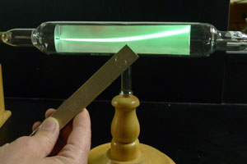
Cathode rays
Discovered that electricity could pass through a vacuum at high enough voltage – had to be something carrying the current – cathode rays
If phosphor was placed along the path of the current through the vacuum it would light up
Turned out to be a beam of electrons that excite the phosphor as they pass by
https://people.chem.ucsb.edu/feldwinn/darby/DemoLibrary/Images/Demo8.jpg

Slide 25
Cathode Ray Tube
Watch the video:
Study.com/academy/lesson/jj-thomsons-cathose-ray-tube-crt-definition-experiment-diagram.html

Slide 26
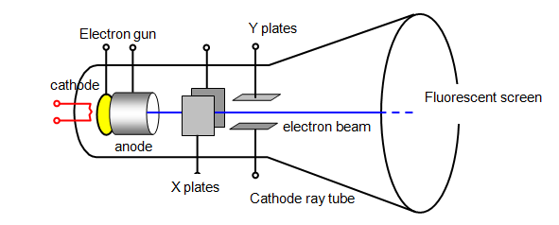
Cathode ray Tube
Cathode ray beam controlled by two sets of charged plates - one to control x position, one for y

Slide 27
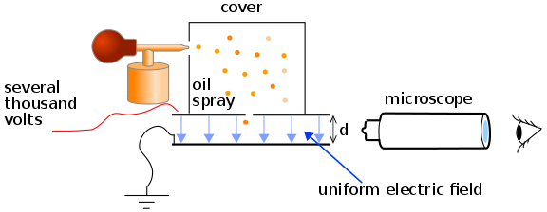
Milikan’s oil drop experiment – determination of charge of an electron
Drops of oil charged by x-rays
Electric field adjusted until drops would sit suspended above the charged plate
From size of drop and strength of electric field to suspend it the charge of the drop could be determined
All values of charge turned out to be integer multiples of a certain number – the charge of a single electron
Watch: Millikan oil drop
https://www.youtube.com/watch?v=nwnjYERS66U

Slide 28

Electric Potential (V)
Electric potential energy per unit charge (J C⁻¹ or V)
This is the work that must be done per unit charge to bring a positive charge from infinity to the point.
$$V=\frac{W}{q}$$
$$V=electric potential \left(V\right)$$
$$W=work \left(J\right)$$
$$q=charge (C)$$
Given on the datasheet as:
$$W=Vq$$

Slide 29

Electric potential Difference (V)
Difference in potential energy between two points in an electric field
Commonly referred to as voltage
If a charged object is moved through an electric field, work is done, the work is equal to the change in energy
If an object is pushed against the field the work done is the gain in potential energy
If an object moves with the field the work done is the gain in kinetic energy
$$W=qV=E_{K}=\frac{1}{2}mv^{2}$$

Slide 30


Work from electric potential difference analogous to work from vertical movement
An object lifted off the ground will gain gravitational potential energy
$$W=∆E=mgh$$
If released it will fall towards the ground converting the gravitational potential energy to kinetic energy
$$KE=W=∆E$$
A positively charged object pulled away from a negatively charged object will gain electric potential energy
$$W=∆E=∆Vq$$
If released it will ‘fall’ towards the negatively charged object converting the electric potential energy to kinetic energy
$$KE=W=∆E$$

Slide 31

Electric potential Difference Example 1
Two parallel charged plates 15 cm apart create an electric field of 2.4 kN C⁻¹. Determine:
Potential difference between the plates.
$$V=Ed=2400×0.15=360 V$$
The gain in kinetic energy if an electron moves from the negative to the positive plate.
$$W=Vq=360×1.6×{10}^{−19}=5.76×{10}^{−17}J$$
The final velocity of the electron if it was initially stationary.
$$E_{K}=\frac{1}{2}mv^{2}=5.76×{10}^{−17}J$$
$$v=\sqrt{\frac{2×5.76×{10}^{−17}}{9.11×{10}^{−31}} }=1.12×{10}^{7} m s^{−1}$$

Slide 32

Electric potential Difference Example 2
A proton is accelerated between two parallel plates 50 mm apart, with an electric field strength of 2.4x10³ N C⁻¹, what is the final velocity of the proton assuming it is initially stationary?
$$V=Ed=2400×0.05=120 V$$
$$W=Vq=120×1.6×{10}^{−19}=1.92×{10}^{−17} J$$
$$v=\sqrt{\frac{2E_{K}}{m}}=\sqrt{\frac{2×1.92×{10}^{−17}}{1.67×{10}^{−27}}}=1.52×{10}^{5} m s^{−1}$$

Slide 33
Magnets
Objects which exert a force on nearby magnets, iron, cobalt or nickel
Exerts a force at a distance by creating a magnetic field
Can be thought of as having two opposing poles, referred to as North and South because they will align with the Earth’s magnetic field if allowed to float freely (e.g. in a compass)
S
N
https://media.giphy.com/media/DlywpQ6BTI7AY/giphy.gif

Slide 34
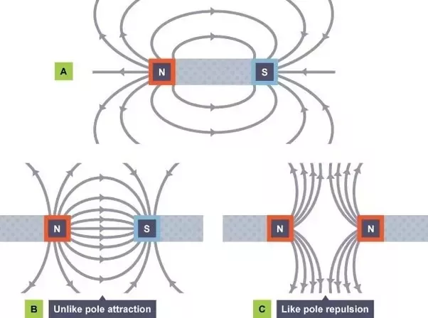
Law of Poles
Opposite poles attract
Like poles repel
https://qph.fs.quoracdn.net/main-qimg-b16f909d05c4d86d7fc69c976e9740f8.webp

Slide 35
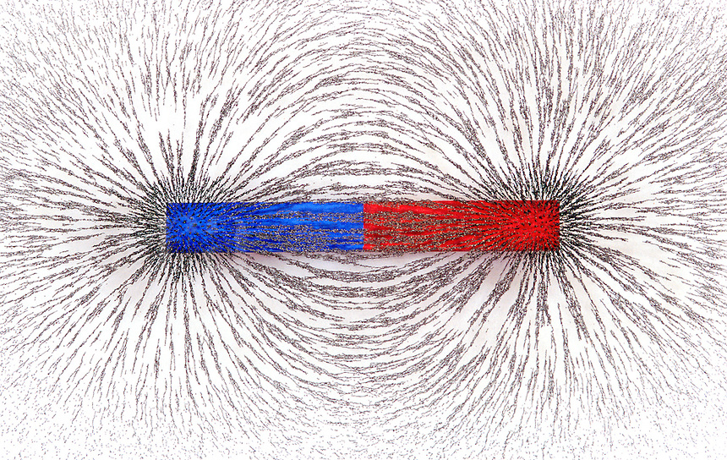
Magnetic fields
A region of space around a magnet in which another magnet, iron, cobalt or nickel will experience a force
Essentially caused by moving electric charges
https://highvelocityinnovation.com/wp-content/uploads/sites/3/2019/05/2019-05-17-What-Is-Pull.jpg

Slide 36
Magnetic field lines
Similar to electric field lines
Lines cannot cross
Density of lines represents strength of magnetic field
Arrow shows the direction a north pole would point (direction a compass would point)

Slide 37
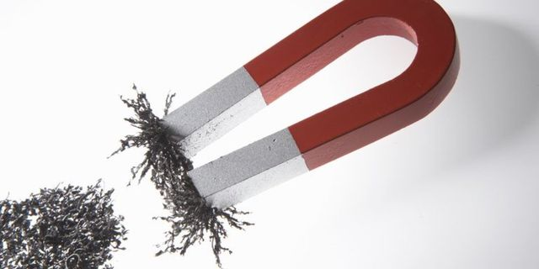
Permanent magnet
A magnet typically made of iron, cobalt and/or nickel
Retains its magnetic behaviour for a long period of time without any input
https://d3ecqbn6etsqar.cloudfront.net/CuprLVrzHyrUEPNS4_6_0jMowBs=/640x320/smart/https://sydneyscience.com.au/app/uploads/sites/7/2019/05/Magic-Magnets.jpg

Slide 38
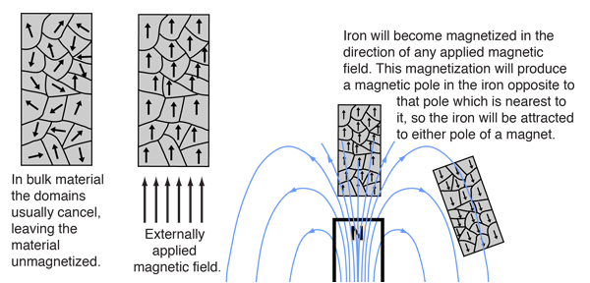
Source of permanent magnets
Permanent magnets are essentially magnetic because they are made of many tiny magnets which are made of tinier magnets which are made of even tinier magnets, all aligned in the same direction, so that they don’t cancel each other out
Magnets are magnetic because they are made of aligned magnetic domains (groups of atoms)
Domains can be magnetic if they are made of aligned magnetic atoms
Magnetic atoms can be magnetic because electrons are intrinsically magnetic
For a given substance to be magnetic the tiny magnets it is made of must align at all these different levels and not cancel each other out, this is rare, so only certain materials are magnetic
http://hyperphysics.phy-astr.gsu.edu/hbase/Solids/ferro.html

Slide 39
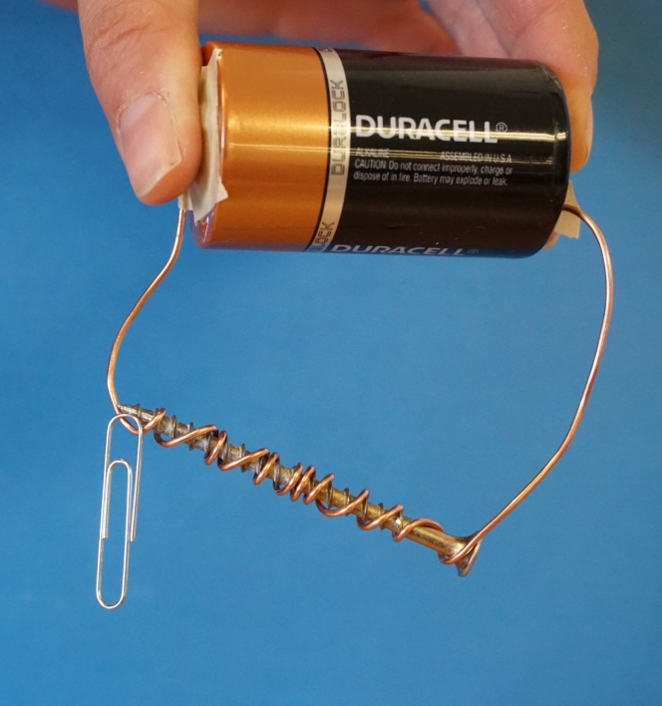
Electromagnet
Magnet created by an electric current
Can be turned on and off
Variable strength dependent on current
Reversible depending on direction of current
http://www.greatbasinobservatory.org/sites/greatbasinobservatory.org/files/images/electromagnet.jpg

Slide 40
Magnetic flux density (B)
Measures the strength of a magnetic field in an area, can be though of as the density of field lines
Is a vector
Units are ‘webers per square meter’ (Wb m⁻²) or Teslas (T)

Slide 41

Magnetic flux (φ)
Measures the total magnetic field an object is exposed to, can be thought of as the total number of field lines passing through an object
Is a vector
Measured in webers (Wb)
$$\text{φ}\text{=}\text{B}A_{⊥} or \text{φ}\text{=}\text{BA}\sin{θ}$$
$$\text{φ}\text{ = }\text{magnetic} \text{flux}\text{ (}\text{Wb}\text{)}$$
$$\text{B}\text{ = }\text{magnetic} \text{flux} \text{density}\text{ (}\text{T}\text{)}$$
$$\text{A}\text{ = }\text{area} \left(m^{2}\right)$$
$$θ=angle between surface and direction of magnetic field (°)$$

Slide 42

Example
Find magnetic flux density in an area of 0.44 m² where the flux is 0.075 Wb
$$0.170 T$$

Slide 43
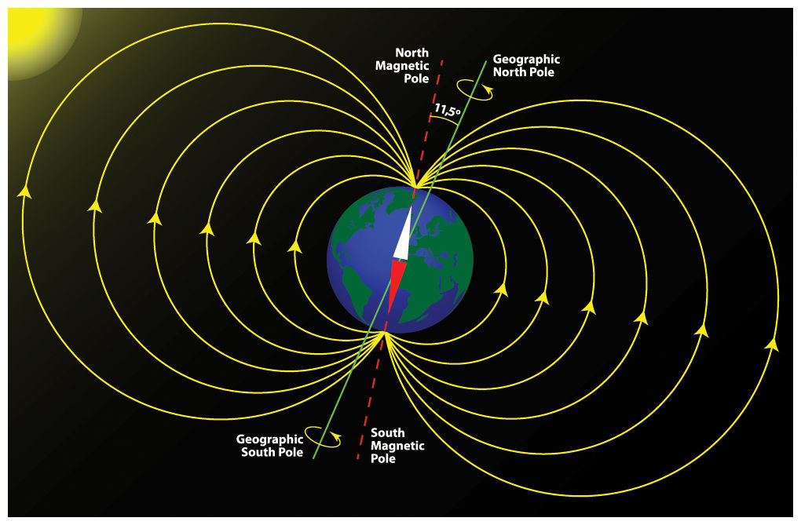
Earth’s magnetic field - Magnetosphere
Thought to be caused by convection in the Earth’s molten metal core
South magnetic pole very close to north geographic pole – angle of declination between the two
https://www.sciencecircle.org/wp-content/uploads/2019/02/earth_magnetic_field_poles.jpg

Slide 44

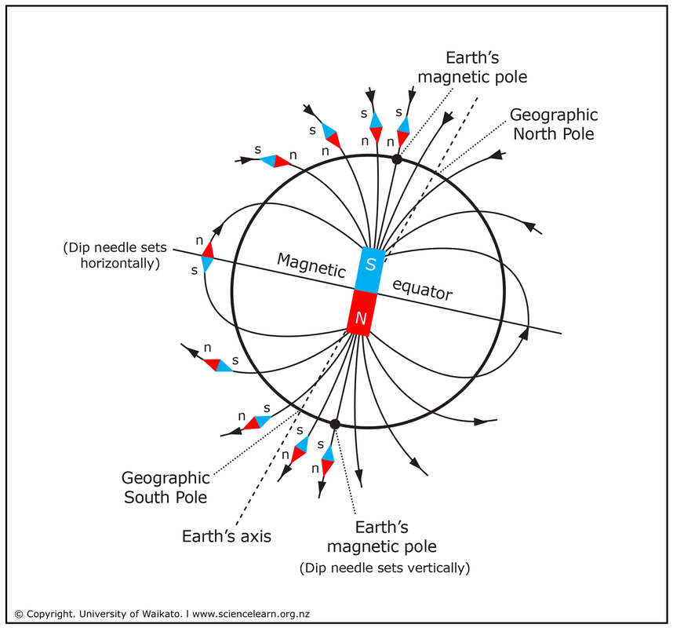
Angle of dip
The Earth’s magnetic field is not consistently parallel to the surface
Close to the equator the field is parallel to the surface
At the magnetic poles the angle of dip is 90°
https://static.sciencelearn.org.nz/images/images/000/001/820/full/_DTP_ART_FossilCompasses_Earth%E2%80%99sMagneticField.jpg?1522303792

Slide 45

Components of magnetic field
Often necessary to find a component of the Earth’s magnetic field, typically the components parallel or perpendicular to the Earth’s surface. Use trigonometry as you would to find components in any other situation.
At a point on the Earth’s surface the magnetic field is 0.050 mT at an angle of 20° to the horizontal, find the vertical and horizontal components of the field.
$$B_{h}=0.050\cos{20}=0.0470 mT$$
$$B_{v}=0.050\sin{20}=0.0171 mT$$

Slide 46
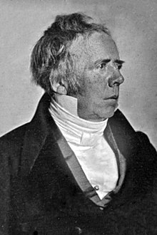
Electromagnetism
In 1820 Hans Christian Ørsted discovered that a wire carrying a current caused a magnet to deflect
Electricity and magnetism are inherently connected, they are collectively referred to as electromagnetism

Slide 47
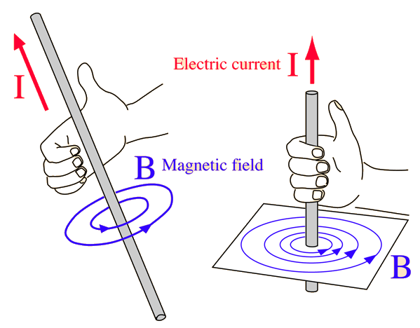
Magnetic field from electric current
Current flowing along a conductor creates a magnetic field around the conductor
Right hand grip rule: with thumb pointing the direction of conventional current, the curled fingers show the direction of the magnetic field
Magnetic field strength is propotional to the current and inversely proportional to distance from the conductor
http://hyperphysics.phy-astr.gsu.edu/hbase/magnetic/imgmag/magcur.gif

Slide 48
Example
Determine the direction of the current.
Up

Slide 49
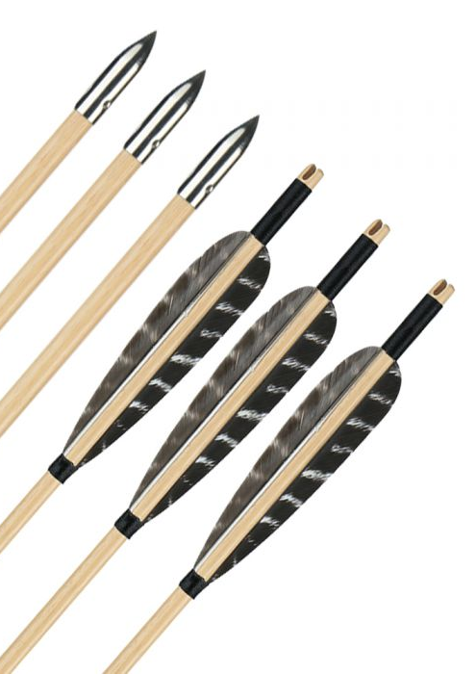
3d Field diagrams on 2d Paper
Field lines can be shown heading into or out of the page
Think of a fletched arrow, the point is heading towards you, the fletching is heading away from you
Out of page Into page
https://www.huntingdoor.com/pub/media/catalog/product/cache/e4d64343b1bc593f1c5348fe05efa4a6/a/w/awmj01t_20190624171858_04.jpg

Slide 50
Example
Show the direction of the magnetic field lines.

Slide 51

Magnetic field strength from a wire
$$B=\frac{μ_{0}I}{2πr}$$
$$B=magnetic flux density (T)$$
$$μ_{0}=magnetic constant=4π×{10}^{−7} N A^{−2}$$
$$I=current \left(A\right)$$
$$r=distance from wire (m)$$

Slide 52
Example
Calculate the magnetic field strength for a long wire carrying 10 A at the following distances:
Plot a graph of the results.
Distance (cm) | Magnetic field strength (T)
10 | 0.00002
20 | 0.00001
40 | 0.000005
60 | 0.000003333
80 | 0.0000025
100 | 0.0000002
Distance (cm) | Magnetic field strength (T)
10
20
40
60
80
100

Slide 54
Current flowing in a loop
Show the direction of the magnetic field all around the loop

Slide 55
Current flowing in a loop side view
Draw the magnetic field line are around the wires.

Slide 56
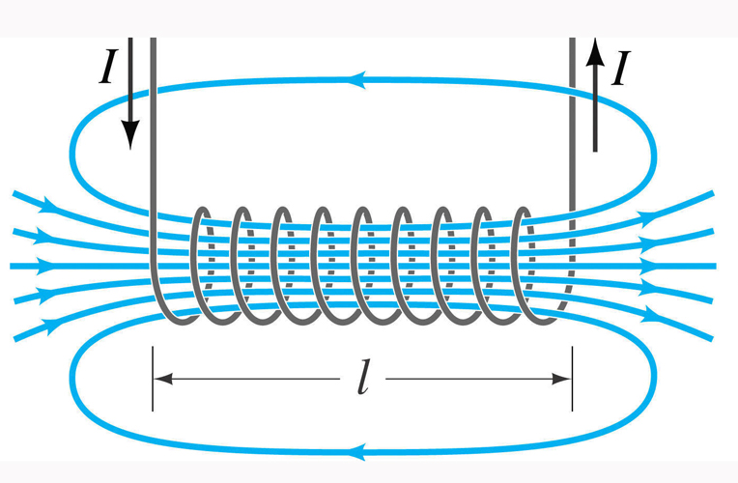
Solenoids
An electromagnet made of many loops of wire
Create a strong uniform magnetic field inside the loops
External magnetic field like that of a bar magnet
Right hand grip – with thumb to the north pole, curled fingers show conventional current
http://www.justscience.in/wp-content/uploads/2017/05/HOW-DOES-A-SOLENOID-WORK.jpg

Slide 57
Remembering solenoid direction
If viewed from the end, if current is flowing anti-clockwise it is the north pole, if current is flowing clockwise it is the south pole
N
S

Slide 58
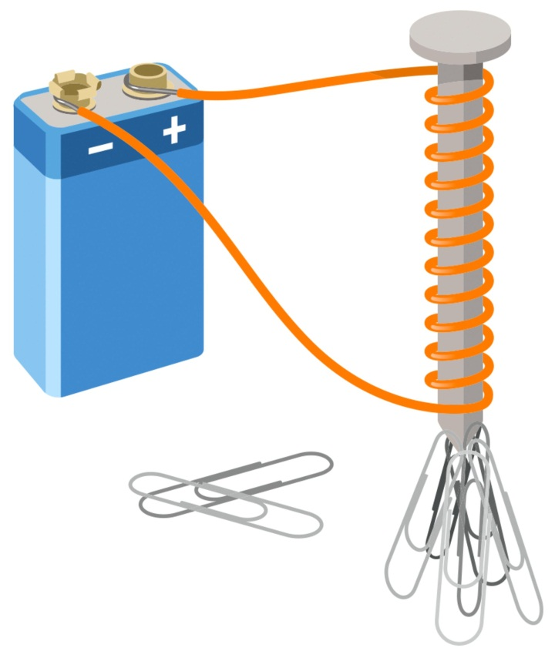
Solenoid electromagnet
A solenoid electromagnet placed over a soft iron core makes a good electromagnet
The soft iron forms a temporary magnet, enhancing the magnetic field while the solenoid is on but losing its magnetic field when it is turned off
Magnet strength depends on current and number of coils
https://res.cloudinary.com/dk-find-out/image/upload/q_80,w_1920,f_auto/DK_aw_Solenoid_FINAL_k4bmdo.jpg

Slide 59
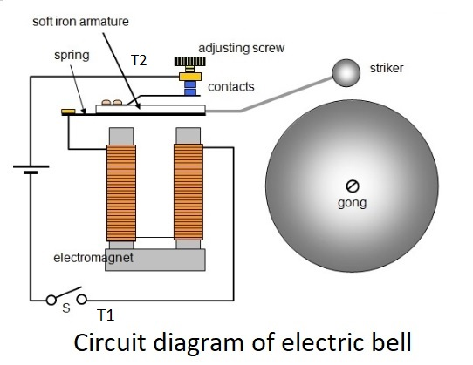
Solenoid application 1 - bells
When circuit switched on the armature is pulled towards the electromagnet causing the striker to hit the bell but also breaking the circuit
The spring causes the armature to return to position completing the circuit, this repeats as long as the circuit is on
https://onlinesciencenotes.com/wp-content/uploads/2019/02/bells.jpg

Slide 60
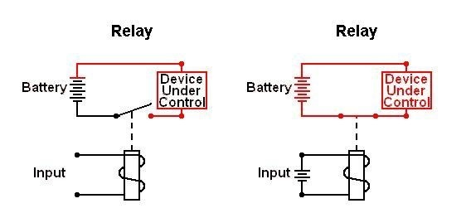
Solenoid applications 2 - Relay
Electromagnet in one circuit used to throw switch in another circuit
Allows low voltage circuit to control high voltage circuit (electrically isolated)
One relay can control multiple other switches
https://www.powerelectronictips.com/solenoids-relays-part-2-faq/

Slide 61
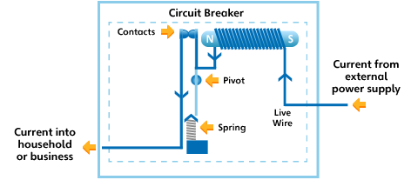
Solenoid application 3 – Circuit breaker
Solenoid in line of circuit
If current becomes too high the solenoid becomes strong enough to break the circuit
https://learnelectricity.ausgrid.com.au/-/media/Microsites/HighSchoolEducation/Images/circuitbreaker_02.gif?w=480&h=207&as=1&la=en&hash=7CE6F98E100F2F4C008AA19D5BE67F83C8AE1B01

Slide 62
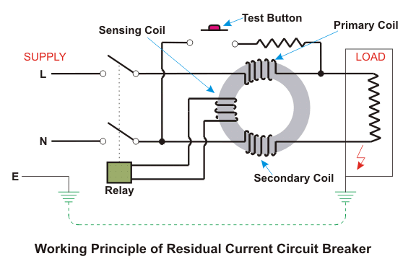
Solenoid Application 4 – Residual Current Device
2 coils powered by the active and the neutral wires attempt to establish opposite electromagnets
If current in one wire is greater than the other it ‘wins’
Triggers a relay to cut the circuit

Slide 63
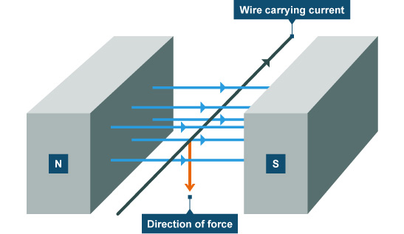
Force on a current in a magnetic field
A wire carrying a current through a magnetic field can experience a force
Maximum force is when the current and field are perpendicular, the resulting force is perpendicular to both the current and the field
https://i.stack.imgur.com/pgZJc.jpg

Slide 64
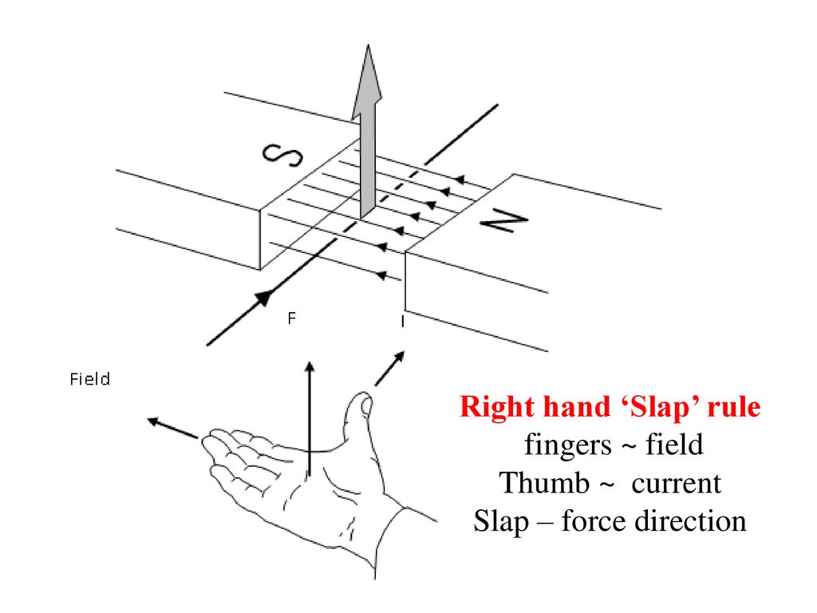
Right hand slap rule
If you align your thumb with the current, and your fingers with the magnetic field, then your palm faces the direction of the force
https://slideplayer.com/slide/15151330/91/images/3/Right+hand+%E2%80%98Slap%E2%80%99+rule+fingers+~+field+Thumb+~+current+Slap+%E2%80%93+force+direction.jpg

Slide 65

Calculating force on a wire in a magnetic field
$$F=IlB_{⊥} or F=IlB\sin{θ}$$
$$F=force \left(N\right)$$
$$I=current \left(A\right)$$
$$l=length of wire \left(m\right)$$
$$B_{⊥}=magnetic field strength \left(T\right)$$
$$θ=angle between direction of magnetic field and wire (°)$$

Slide 66

Example
Determine the magnitude of the force due to the Earth’s magnetic field, on 1m of a suspended power line running east west and carrying a current of 100 A if the magnetic field strength at that location is 5 x10⁻⁵ T.
$$F=100×1×5×{10}^{−5}=5×{10}^{−3}N$$

Slide 67

Example 2
Determine the magnitude of the force due to the Earth’s magnetic field, on 1m of a suspended power line running north south and carrying a current of 100 A if the magnetic field strength at that location is 5 x10⁻⁵ T and the dip angle is 40°.
$$F=100×1×5×{10}^{−5}\sin{40}=3.21×{10}^{−3}N$$

Slide 68
Explanation for force on a wire using field lines
Recall that field lines will not cross, can’t have two lines heading in opposite directions next to each other
S
N
S
N
S
N
S
N

Slide 69
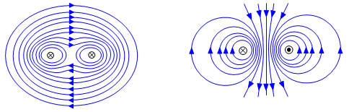

Force between two parallel wires
Two current carrying wires running parallel will exert a force on each other
If the current is in the same direction in both wires they will attract each other
If the current is in opposite directions they will repel each other
Calculate magnitude of force by combining previous formulae
$$B=\frac{μ_{0}I}{2πr} and F=IlB_{⊥}$$
$$F=\frac{μ_{0}I_{1}I_{2}l}{2πr}$$
http://www.schoolphysics.co.uk/age16-19/Electricity%20and%20magnetism/Electromagnetism/text/Forces_between_currents/index.html

Slide 70
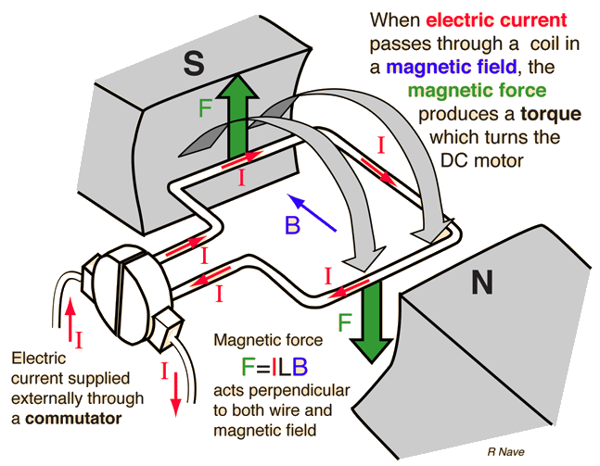
Motor Basics
Coil of N loops placed between two magnets
Each side of the coil experiences a force in opposite directions when current flows through the coil – causes torque - causes rotation
Commutator flips direction of current in the coil twice every rotation maintaining constant direction of rotation
http://hyperphysics.phy-astr.gsu.edu/hbase/magnetic/imgmag/dcmop.gif

Slide 71
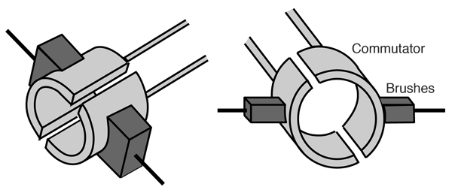
Split-ring Commutator
Allows direction of current in coil to flip in sync with the rotation of the coil
http://hyperphysics.phy-astr.gsu.edu/hbase/magnetic/imgmag/comtat.png

Slide 72
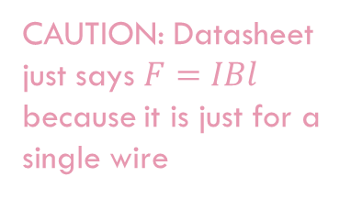

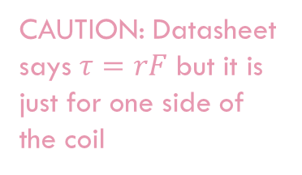
Determining Maximum torque on coil
Force on one side of the coil:
$$F=NIBl$$
Torque supplied by coil:
$$τ=2rF so τ=2rNIBl$$
$$2rl=A so:$$
$$τ=NAIB$$
$$τ=torque \left(N m\right)$$
$$r=distance from axis of rotation to edge of coil \left(m\right)$$
$$A=area of the coil (m^{2})$$
CAUTION: Datasheet just says $F=IBl$
because it is just for a single wire
CAUTION: Datasheet says $τ=rF$ but it is just for one side of the coil

Slide 73

Example
A DC motor made of a 6 cm square coil with 300 turns. If the current through the coil is 2 A and the magnetic field is 0.55 T determine:
a) The size of the force on one edge of the coil.
$$F=nIBl=300×2×0.55×0.06=19.8 N$$
b) The torque on the coil.
$$τ=nAIB=300×0.0036×2×0.55=1.19 N m$$
c) Sketch a torque/time graph for 1 cycle if f=10 Hz and it starts at F_{max}

Slide 75
Simple motor problems
When the coil sits at a right angle to the field lines the torque on the coil is zero, only keeps turning due to inertia – jerky motion

Slide 76
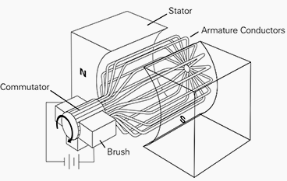
Motor improvements
Multiple coils each attached to their own commutators to create smoother more consistent torque
Curved electromagnets (stator) to maximise torque
https://electrical-engineering-portal.com/4-types-of-dc-motors-and-their-characteristics

Slide 77
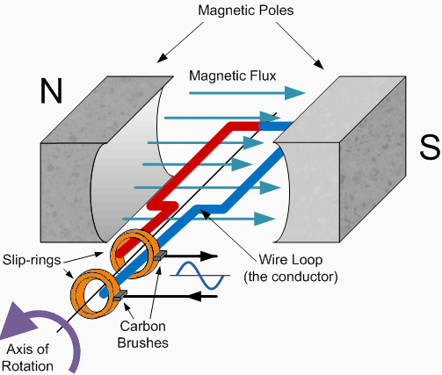
AC motor
Instead of split ring commutator with DC can use 2 slip-ring system with AC
Current changes direction at correct frequency to maintain constant direction of torque

Slide 78
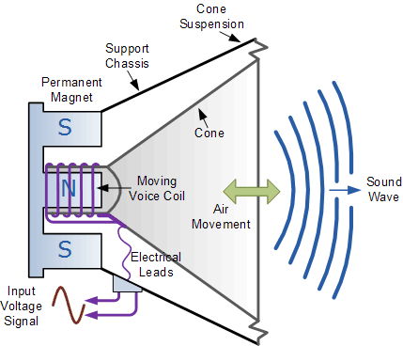
Speakers
Coil which can slide back and forth over the central pole of a circular permanent magnet
Alternating current through coil makes the coil vibrate the frequency of the AC
Vibrating coil vibrate cone which transfers the energy to the air as sound waves

Slide 79
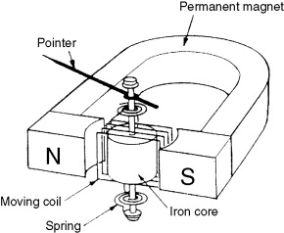
Ammeters
DC flows through coil – causes coil to experience torque related to current
Coil rotates against a spring until spring torque = magnetic torque
https://ars.els-cdn.com/content/image/3-s2.0-B9780123819604000073-f07-03-9780123819604.jpg

Slide 80

Deflection of a charged particle by a magnetic field
Recall mass spectrometers
$$F=qvB_{⊥}$$
$$F=force \left(N\right)$$
$$q=charge \left(C\right)$$
$$v=velocity \left(m s^{−1}\right)$$
$$B_{⊥}=magnetic field strength perpendicular to velocity (T)$$
Note: still use right hand slap to determine direction as you would for the force on a wire

Slide 81
Force on a charged particle moving through a magnetic field
Force is always perpendicular to the direction of movement – circular movement
Does the image of a charged particle entering a magnetic field show the path of a positive particle or a negative particle?
positive

Slide 82

Path of a charged particle through a magnetic field
Charged particles follow a path that is an arc of a circle of radius r
$$F=qvb=\frac{mv^{2}}{r}$$
$$r=\frac{mv}{Bq}$$

Slide 83

Example
An electron is accelerated between two charged plates (32 kV) through a distance of 30 cm. The electron is then fired into a 0.2 T magnetic field perpendicular to the field.
a) Find the electric field strength acting on the electron.
$$E=\frac{V}{d}=\frac{32000}{0.3}=107000 N C^{−1}$$
b) Find the electrons velocity as it leaves the plates.
$$F=Eq=107000×1.6×{10}^{−19}=1.71×{10}^{−14} N$$
$$a=\frac{F}{m}=\frac{1.71×{10}^{−14}}{9.11×{10}^{−31}}=1.87×{10}^{16} m s^{−2}$$
$$v=\sqrt{u^{2}+2as}=\sqrt{2×1.87×{10}^{16}×0.3}=1.06 ×{10}^{8} m s^{−1}$$
c) Find the radius of the electron’s path.
$$r=\frac{mv}{qB}=\frac{9.11×{10}^{−31}×1.06 ×{10}^{8}}{1.6×{10}^{−19}×0.2}=0.00302 m$$

Slide 84
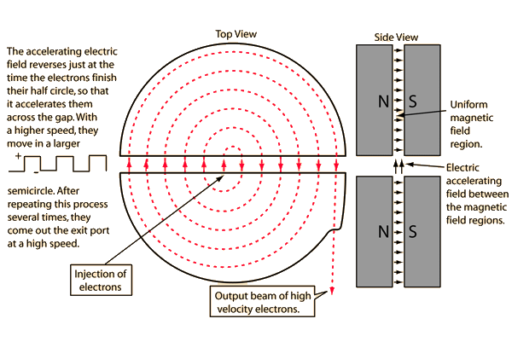
Cyclotron
Particle accelerator – creates focused beam of high energy particles
Smaller and often cheaper than equivalent linear particle acclerators
Range in size from 8 cm to 17 m in diameter
Can be used to make radioisotopes for nuclear medicine e.g. Tc-99m
http://hyperphysics.phy-astr.gsu.edu/hbase/magnetic/imgmag/cyclo.gif

Slide 85

Cyclotron calculations
$$Bqv=\frac{mv^{2}}{r}$$
$$Bq=\frac{mv}{r}$$
$$v=\frac{2πr}{T}=2πrf$$
$$Bq=\frac{2πfrm}{r}$$
$$f=\frac{Bq}{2πm}$$
The frequency is independent of both radius and velocity so frequency can remain constant for the whole path of the particle

Slide 86
Induction
Farady realised that if a current can cause a magnetic field then a magnetic field should be able to cause electric current
A current can be induced by:
Moving a magnet in or out of a coil
Switching an electromagnet on or off
Moving the coil in a magnetic field
An electromagnet connected to AC
Essentially you need relative motion between a conductor and a magnetic field

Slide 87
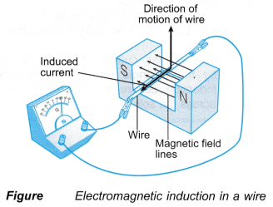

Induced EMF across a straight moving conductor
$$ε=lvB_{⊥}$$
$$ε=induced electromotive force \left(V\right)$$
$$l=length of conductor \left(m\right)$$
$$v=velocity of conductor \left(m s^{−1}\right)$$
$$B_{⊥}=magnetic field strength perpendicular to velocity (T)$$
https://i1.wp.com/c2.staticflickr.com/4/3852/33618724075_507d3bd98e_o.png?resize=328%2C249&ssl=1

Slide 88
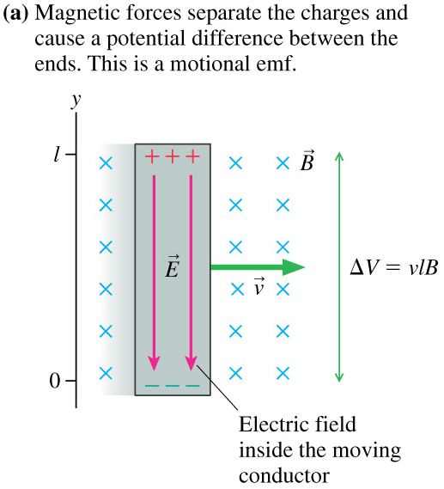
Induced emf – charge separation
Induced EMF is a result of separation of charge in a conductor
Consider electrons in a metal bar moving through a magnetic field
Each will experience a force as a charged particle moving through a magnetic field
They can be pushed towards one end of the conductor
Protons would also experience a force in the opposite direction but are unable to move

Slide 89

Example
An airplane flies through the Earth’s magnetic field.
a) At which points will the induced emf be a maximum and at which will it be a minimum?
The emf would be a minimum (0) where the Earth’s magnetic field is parallel to the direction the plane is travelling (close to equator if the plane is travelling horizontally in the N-S direction) and a maximum where the field is perpendicular to the direction the plane is heading (at the magnetic poles if the plane is travelling horizontally)
b) If it has a wingspan of 64 m and is flying at 990 km h⁻¹ through a magnetic field of 60 μT, determine the maximum emf that could be induced across the wings.
$$ε=lvB=64×\frac{990}{3.6}×60×{10}^{−6}=1.06 V$$

Slide 90
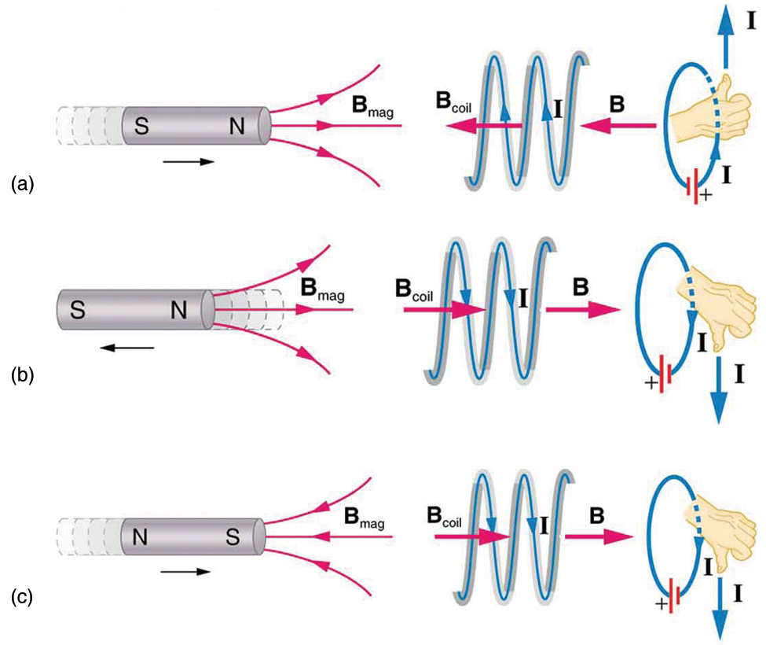
Induced EMF in coils - Lenz’s Law - Conservation of energy
An induced emf can establish a current
Such a current sets up a magnetic field which acts to oppose the change in magnetic flux
The result is a force opposing the movement
Electrical energy is not created from nowhere, the kinetic energy of the movement is converted to the electrical energy
https://opentextbc.ca/physicstestbook2/wp-content/uploads/sites/211/2017/10/Figure_24_02_01.jpg

Slide 91

(AVERAGE) Induced EMF in coils – Faraday’s Law
The induced emf in a coil is directly proportional to the rate of change of magnetic flux cutting the coil
$$ε=−N\frac{∆Φ}{t}=−N\frac{∆\left(BA_{⊥}\right)}{t}$$
$$ε=induced electromotive force \left(V\right)$$
$$N=number of turns in the coil$$
$$Φ=magnetic flux \left(Wb\right)$$
$$t=time \left(s\right)$$
$$B=magnetic field strength \left(flux density\right)\left(T\right)$$
$$A_{⊥}=area of coil perpendicular to magnetic field (m^{2})$$

Slide 92

Example
A student places a horizontal 5 cm square coil into an upwards vertical 0.1 T magnetic field
a) How much flux cuts the coil?
$$φ=BA=0.1×{0.05}^{2}=0.00025 Wb$$
b) Determine the emf and direction of current in the coil if it is pulled out of the field in 1 s
$$ε=N\frac{Δφ}{t}=1\frac{0−0.00025}{1}=0.00025 V$$
Since the upwards magnetic field through the coil is decreasing the current will flow to increase the upwards magnetic field i.e. it will flow counter-clockwise viewed from above
c) Determine the emf and direction of current in the coil if it is pushed back in in 0.5 s
$$ε=N\frac{Δφ}{t}=1\frac{0−0.00025}{0.5}=0.0005 V$$
Since the upwards magnetic field through the coil is increasing the current will flow to decrease the upwards magnetic field i.e. it will flow clockwise viewed from above

Slide 93
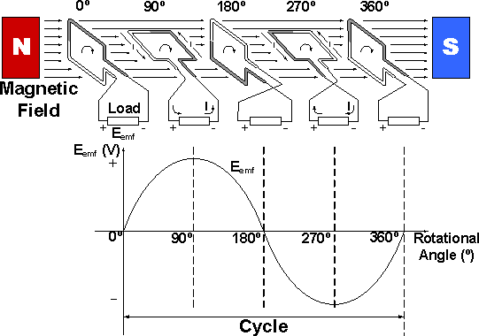
Example 2
A student places a horizontal 5 cm square coil into an upwards vertical 0.1 T magnetic field
Describe the current in the coil if the student rotates the coil 360° in 2 s.
The emf and therefore the current will be at a minimum initially while the coil is horizontal, this is a maximum for magnetic flux but a minimum for rate of change of magnetic flux and therefore emf. As it is rotated the emf and therefore current increases reaching a maximum when the coil is parallel to the magnetic field as this is a point of maximum rate of change of magnetic flux. The current will then decrease until the coil is once again perpendicular to the magnetic field at which point
current will be zero before it moves through the same
pattern in the opposite directions

Slide 94

Example 3
A 40 cm², 20 turn coil is placed horizontally in a 0.1 T vertical magnetic field. The coil is connected to a galvanometer (≈ analogue ammeter) with a resistance of 200 Ω.
a) How much flux passes through the coil?
$$φ=BA=0.1×40×{10}^{−4}=4.00×{10}^{−4} Wb$$
b) If the coil is withdrawn in 0.5 s, what current flows through it?
$$ε=N\frac{Δφ}{t}=20\frac{0−4×{10}^{−4}}{0.5}=0.016 V$$
$$I=\frac{V}{R}=\frac{0.016}{200}=8.00×{10}^{−5} A$$

Slide 95
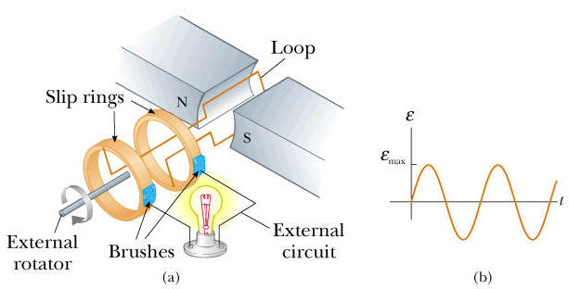
Generators
Make use of induction to create a useful electric current
Need a coil moving relative to a magnetic field
Simple to create AC, can also create DC with split ring commutator
https://www.physics.byu.edu/faculty/christensen/Physics%20220/FTI/31%20Faraday%27s%20Law/31.19%201.jpg

Slide 96

Example
A generator with a 100 turn, 30x12 cm coil rotates in a 0.2 T magnetic field with a frequency of 2 Hz. Determine the average emf induced in the coil.
$$ε=N\frac{Δφ}{t}=100\frac{0−0.3×0.12×0.2}{\frac{1}{2}÷4}=5.76 V$$
Important to recognise that in a quarter of a turn the flux goes from a maximum to zero, so time should be a quarter of the period.
Also, this formula is just referred to as induced emf on the datasheet, but it is what you use if the question asks for ‘average emf’.

Slide 97

Root mean square emf
For alternating current, the RMS is equal to the value of the direct current that would produce the same average power in a circuit.
$$ε_{rms}=\frac{ε_{max}}{\sqrt{2}}$$
To find the RMS emf you need the maximum emf
$$ε_{max}=2NlvB=2πNBA_{⊥}f$$

Slide 98

Example
A 10 cm square coil of 400 turns is rotated at 25 Hz in a magnetic field of 0.1 T.
a) Find the maximum induced emf.
$$ε_{max}=2πNBA_{⊥}f=2π×400×0.1×0.1×0.1×25=62.8 V$$
b) Assuming maximum flux is at t = 0 s sketch the emf as a function of time for 0.12 s

Slide 99

Example 2
A 40 turn 15x25 cm coil is rotating at 1500 rpm in a 0.35 T magnetic field.
a) Determine the max emf produced by the coil.
$$ε_{max}=2πNBA_{⊥}f=2π40×0.35×0.15×0.25×\frac{1500}{60}=82.5 V$$
b) Determine the RMS voltage produced.
$$ε_{rms}=\frac{ε_{max}}{\sqrt{2}}=\frac{82.5}{\sqrt{2}}=58.3 V$$
c) Determine the peak voltage if the frequency is doubled.
$$ε_{max}=2πNBA_{⊥}f=2π40×0.35×0.15×0.25×\frac{3000}{60}=165 V$$

Slide 100
DC Generator
Split ring commutator to flip direction of emf/current
Split ring commutator can introduce problems; wear on brushes, sparking as it crosses
Not a smooth emf/current
Add multiple coils to smooth out

Slide 101
Back emf
Generators and motors are virtually the same machine, once they are running, there are effectively both present
An operating motor will act as a generator; inducing an emf that opposes the emf driving the motor
Back emf is proportional to the angular velocity of the motor
When a motor is fist turned on the velocity is low so the back emf is low so current is high allowing for maximum ability to do work; spin up to speed
If a motor is kept on but jammed, unable to turn, current will remain high for a long time, potentially burning out the device
If the motor is running smoothly the velocity will increase until back emf is almost equal to the driving emf so it will just draw enough current to overcome friction a turn at constant velocity
If a load is applied to the motor, it effectively increases friction, decreasing velocity and therefore back emf, so current increases allowing for more work to be done

Slide 102
Counter torque
Generators and motors are virtually the same machine, once they are running, there are effectively both present
An operating generator will act as a motor; creating a torque that opposes the driving torque on the generator
Counter torque is proportional to the current in the coil
A turning generator with no load has an emf but no current so there is no counter torque
Once the circuit is completed, including a load, the current will flow causing counter torque, increasing the driving torque needed to turn the generator at a given frequency
If the driving torque is kept constant the back torque will vary until it and friction balance the driving torque resulting in a constant speed of rotation

Slide 103
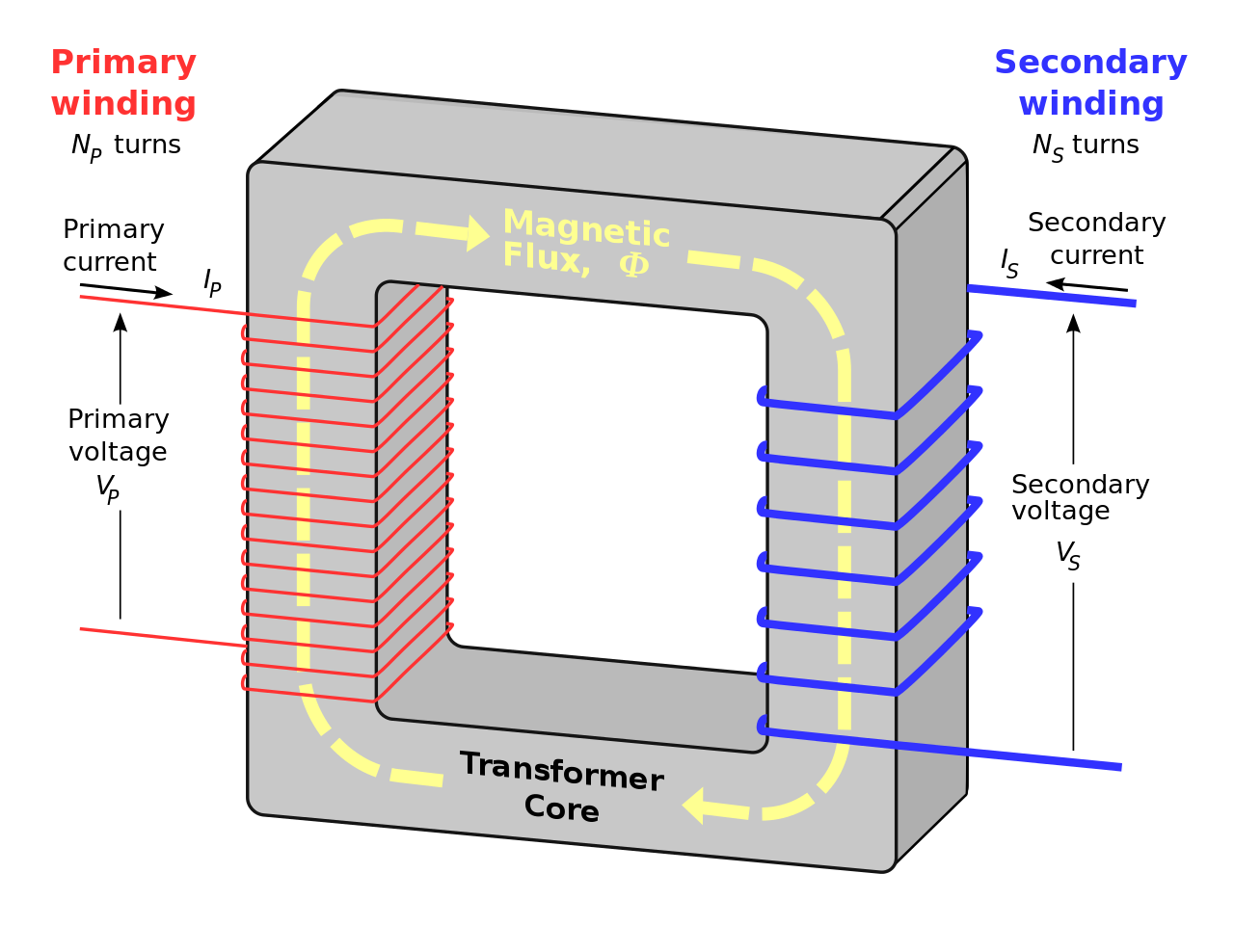

Transformers
Device for increasing or decreasing AC voltage
Requires two coils, changing flux produced by the first coil induces emf in the second coil
Iron core ensures all flux from first coil passes through second
$$\frac{Vp}{Vs}=\frac{Np}{Ns}$$
https://upload.wikimedia.org/wikipedia/en/thumb/e/e7/Transformer3d_col.svg/1280px-Transformer3d_col.svg.png

Slide 104
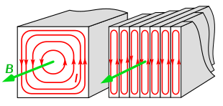
Transformer details
Step-up transformer: increases voltage – more turns in secondary coil
Step-down transformer: decreases voltage – fewer turns in secondary coil
Iron core laminated: made of thin insulated sheets to reduce eddy currents and therefore energy loss as heat – increases efficiency
While voltage is transformed, power remains constant (assuming 100% efficiency)
https://upload.wikimedia.org/wikipedia/commons/thumb/e/ea/Laminated_core_eddy_currents_2.svg/620px-Laminated_core_eddy_currents_2.svg.png

Slide 105

Example
A model train transformer outputs at 12V.
a) If the secondary coil has 100 turns, how many does the primary coil have?
$$\frac{V_{p}}{V_{s}}=\frac{N_{p}}{N_{s}}=\frac{240}{12}=\frac{N_{p}}{100}$$
$$N_{p}=2000$$
b) If the train requires 4 A, what current and power is drawn from the mains?
$$P=VI=12×4=48 W$$
$$I=\frac{P}{V}=\frac{48}{240}=0.2 A$$

Slide 106

Example 2
A 120 W, 24 V AC supply is connected to the input of a transformer. The primary coil has 240 turns. The output is 72 V.
a) Find the number of turns in the secondary coil.
$$\frac{V_{p}}{V_{s}}=\frac{N_{p}}{N_{s}}=\frac{24}{72}=\frac{240}{N_{s}}$$
$$N_{s}=720$$
b) Name the type of transformer.
Step-up transformer
c) Determine the output current.
$$P=120=VI=72×I$$
$$I=1.67 A$$

Slide 107

Transmission of Power
Power is generated at power plants and must be distributed across large distances
Current travelling through a wire will lose power due to resistance converting the electrical energy to heat
$$P=VI but P_{loss}=I^{2}R$$
Therefore if voltage is increased but current reduced the same power can be transmitted with less power loss – transmit power at extremely high voltages to minimise power loss
transformers are key to our power transmission
major advantage of AC – transformers easily step voltage up and down with AC

Slide 108
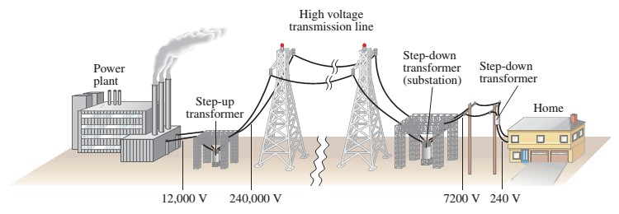

Slide 109

Example
During peak demand, 635 MW is provided to Perth from Muja Power Station along a 2 Ω power line.
What would be the power loss if the potential at Muja was 500 kV?
$$I=\frac{P}{V}=\frac{635000000}{500000}=1270 A$$
$$P_{loss}=I^{2}R={1270}^{2}×2=3.23 MW$$
b) Since the current will remain constant, what will the potential be at Perth?
$$V=\frac{P}{I}=\frac{635000000−3230000}{1270}=497 kV$$

Slide 110

Example 2
A 20 kW, 400 V diesel generator supplies power for 400 V lights on a film set at an outside location. The 500 m transmission cable has a resistance of 5 Ω. If 2 transformers are used with 1:20 ratio in turns.
a) What is the current in the cables?
$$V_{s}=\frac{N_{s}}{N_{p}}V_{p}=\frac{20}{1}400=8000 V$$
$$I=\frac{P}{V}=\frac{20000}{8000}=2.5 A$$
b) What is the voltage drop across transmission cables?
$$V=IR=2.5×5=12.5 V$$
c) What is the power loss in the cables as a percentage of power supplied by the generator?
$$P_{loss}=I^{2}R={2.5}^{2}×5=31.25 W or 0.156\%$$
d) What voltage is supplied to lights?
$$\frac{8000−12.5}{20}=399 V$$

Slide 111

Example 3
An AC generator produces 10 kW of power to be transmitted at 240 V down a 5 km line of 1.5 Ω resistance.
a) Determine the power loss in the line.
$$I=\frac{P}{V}=\frac{10 000}{240}=41.7 A$$
$$P_{loss}=I^{2}R={41.7}^{2}×1.5=2.60 kW$$
b) Determine the voltage at the end of the line.
$$V=\frac{P}{I}=\frac{10000−2604}{41.7}=178 V$$

Slide 112
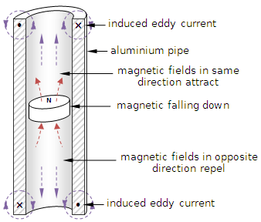
Magnet dropped, South side down, down copper tube
As the magnet falls down, the tubing below it is experiencing an increase in upwards magnetic flux, this creates clockwise (from above) current in the tube to create an opposing magnetic field, this repels the magnet from below, slowing its fall
The tubing above is experiencing a decrease in upwards magnetic flux so the current flows counter-clockwise (from above) to create an increase in upwards magnetic field, this attracts the magnet from above also slowing its descent
The same occurs if the magnet is dropped north side down, just with all directions of field and current reversed
Lenz’s law, the gravitational potential energy is converted not just to kinetic energy as the magnet falls, but also to electrical energy, as the total quantity of energy is conserved, the magnet must gain less velocity (kinetic energy) as it falls
http://4.bp.blogspot.com/-RVsRpgs9jlQ/VAi8OMLnUII/AAAAAAAAACY/LR_Bn2zZvNE/s1600/Lenz.png

Slide 113
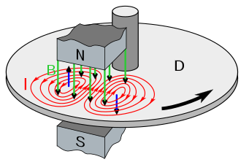
braking
Regenerative braking; when braking the cars motor can behave as a generator, turning kinetic energy back into electrical energy
Electromagnet brakes; electromagnets switched on in metal wheel disc, creates circular currents in the disc (eddy currents) which oppose the changing magnetic field, slowing the wheel
https://upload.wikimedia.org/wikipedia/commons/thumb/5/50/Eddy_current_brake_diagram.svg/660px-Eddy_current_brake_diagram.svg.png

Slide 114
Eddy currents – crack detection
Test coil brought near conductor, establishing eddy currents
Physical defects in the conductor will weaken the eddy currents, weakening the magnetic field they establish so the presence of defects can be detected
Can also be used for the measurement of the thickness of layers of conductive material – maintenance of aircraft wings, pipes etc. looking for corrosion or erosion of thin layers
Magnetic Field
From Test Coil
Magnetic Field From Eddy Currents
Crack
Eddy Currents

Slide 115
Induction hot plate
Electromagnet on AC in stove
Sets up large eddy currents in the thick metal pot base, generating heat due to resistance

Slide 116
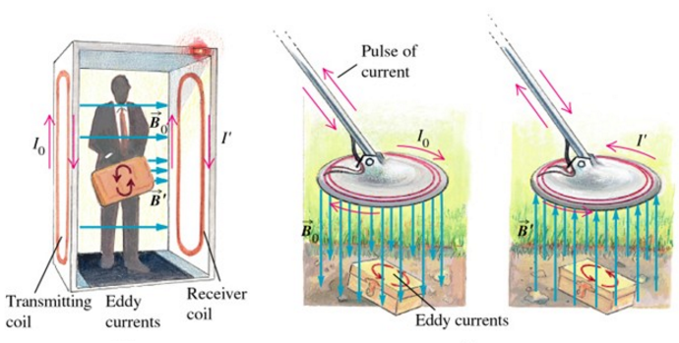
Eddy currents – Metal detectors
Transmitting coil creates magnetic field which establish eddy currents in conductive materials – does not have to be magnetic
Eddy currents establish magnetic field which is detected by receiver coil because it induces a current
https://www.hardware-pro.com/wp-content/uploads/2016/10/Eddy-Currents-2-Hardware-Pro.bmp

Slide 117
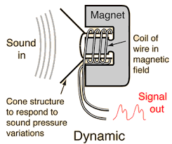
Moving coil microphone
Same as a loudspeaker in reverse
Sound waves vibrate cone at certain frequency causing coil to vibrate at the same frequency
Relative motion induces current in the coil alternating at the same frequency as the sound waves
Current passed on to computer for interpretation

Slide 118
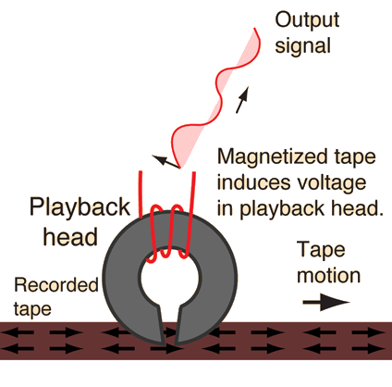
Magnetic tape – cassette tapes, VHS, credit card strip
Thin tape containing microscopic magnetic particles
Magnetic domains in the particles can be aligned in an organized manner to store information
As the tape passes by the gap in the iron core, the flux from the magnetic tape passes through the core, inducing a current in the coil
Process can essentially be reversed to encode information into the tape
http://hyperphysics.phy-astr.gsu.edu/hbase/Audio/imgaud/tape4.gif

Slide 119
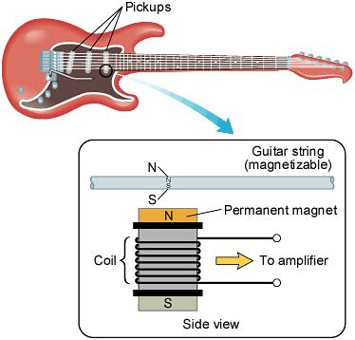
Electric guitar pickup
The permanent magnet magnetises the guitar string.
As the string is plucked and moves a changing magnetic field induces an emf and therefore current in the coil.
The current alternates at the same frequency as the string and therefore the sound.

